Slide 1
Emotion 受け取りたい or 共有したい
課題
疎遠となっている知人との良いきっかけがないから上手くコミュニケーションがとれない
解決策
2人が話せる話題を受け取る（私たちからすると提供する）ことできっかけをつくりコミュニケーションをとりやすくする
Emotionを受け取る

Slide 2

Team 緑の爪(Midori-no-tsume)
Naoto Nishida, Masahito Imai,
Yuta Takayama, Tsukasa Nakamura
Mentors : Terada Atsushi-san, Wakita Kenya-san

Slide 3

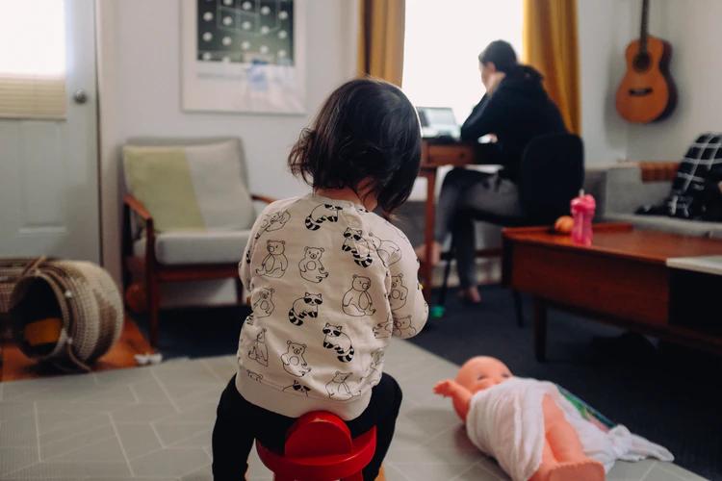
Issue
Background
COVID-19 stops face-to-face lectures
Almost students live away from home
Some parents live away from their children because of their works
Lack of communication opportunity with people
who are hard to meet or don't talk much
Notes:
We will explain the Emolog Services later.
First I'll show the issues.
These days COVID-19 is spredding . Therefore face to face lectures were stoped.
And almost students live away from home .
And Some parents live away from their children because of their works.
That is to say , we can say Lack of communication opportunity with people who are hard to meet or don't talk much usually.

Slide 4

課題
背景
新型コロナウイルスによって対面授業がなくなった
多くの学生は親元を離れて生活している
単身赴任などで子どもあまり会えない
普段疎遠な人たちのコミュニケーションの機会が不足している

Slide 5




Issues
Popular SNS
Twitter
Viber、LINE
1-to-many → hesitate to talk due to public
1on1→ hard to start conversations with who you are losing touch
Notes:
Next , Can popular SNS solve the issue ?
Twitter is the communication tool on a one to many. Therefore the people who are hard to meet or don't talk much usually hesitate to talk due to public.
Viber and Line are the communication tool on a one on one basically. But It's hard for the people who are losing topics to start conversations .

Slide 6
Issues
Popular SNS
Twitter
Viber、LINE
1対多 → 公の場でのコミュニケーションがためらわれる
1対1→ 疎遠となっている人とは話題がないとあまり話せない

Slide 7
Solution
Provide 1 on 1 communication opportunities and topics
by our proposal services
Methods
Extract emoji from lifelogs automatically (based on SNS log, geographical information)
Post generated EmoLogs to your chat rooms and give you a topic
Notes:
Next , we propose the solution of the issue.
We propose the services which provides 1 on 1 communication opportunities and topics.
I'll explain the methods simply.
First , Extract emoji from lifelogs like SNS log, geographical information automatically
Next ,
Post generated EmoLogs by the data your chat rooms and give you a topic

Slide 8
どう解決するか Solution
話題と一対一でのコミュニケーションの場を提供する
Give topics & chances for 1-to-1 communications
具体的な方法 Concrete methods
一日のログ（life log）から絵文字を自動で作成する
Generate EmoLog automatically from life logs
作成した絵文字を個人チャットルームに投稿し話題を提供する
We post generated EmoLogs to your chat rooms and give you a topic

Slide 9
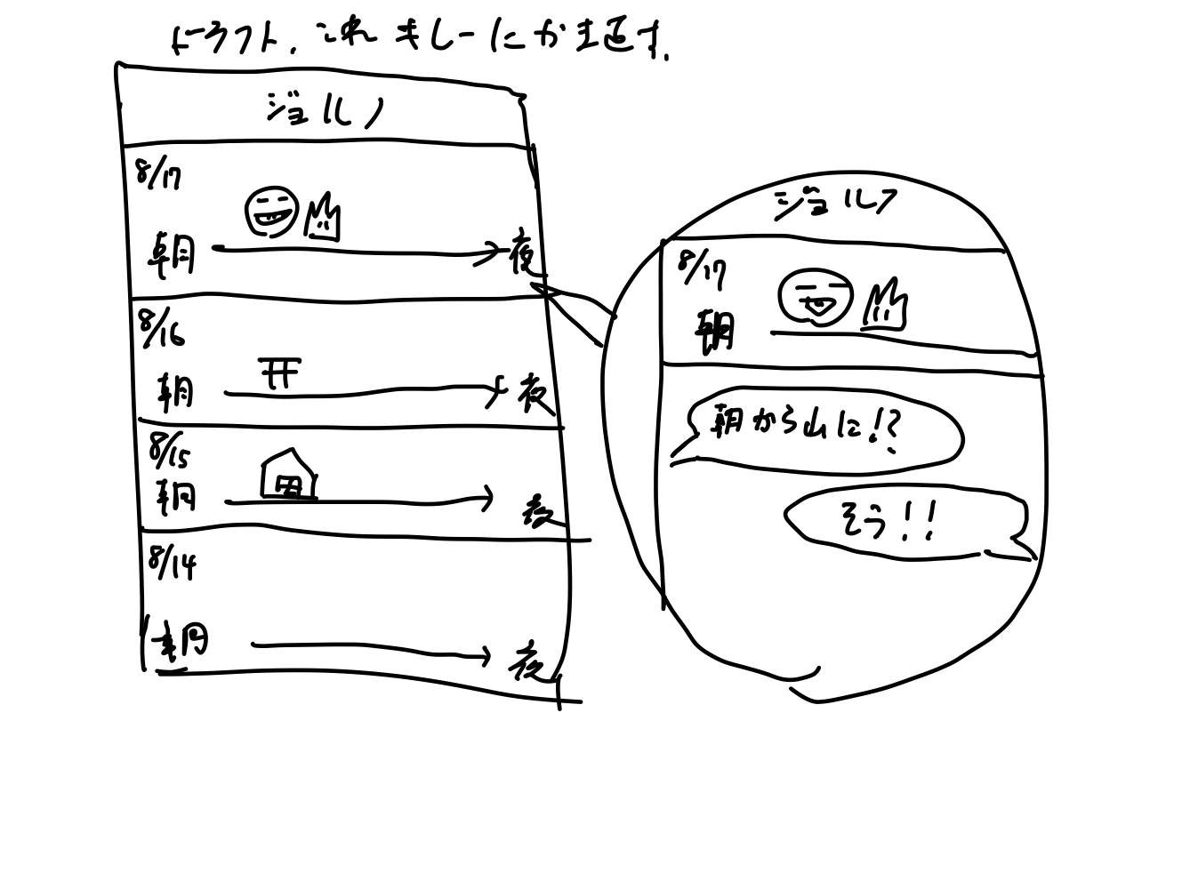
プロダクト概要説明
絵文字で表現された1日の生活のログ(=EmoLog)を毎日ポスト
絵日記のようなイメージ
生活ログにはコメントできる (ユニキャスト方式, 他SNSはブロードキャストが多い)
会話によって抽象的な日記の内容を深掘りていく)

Slide 10
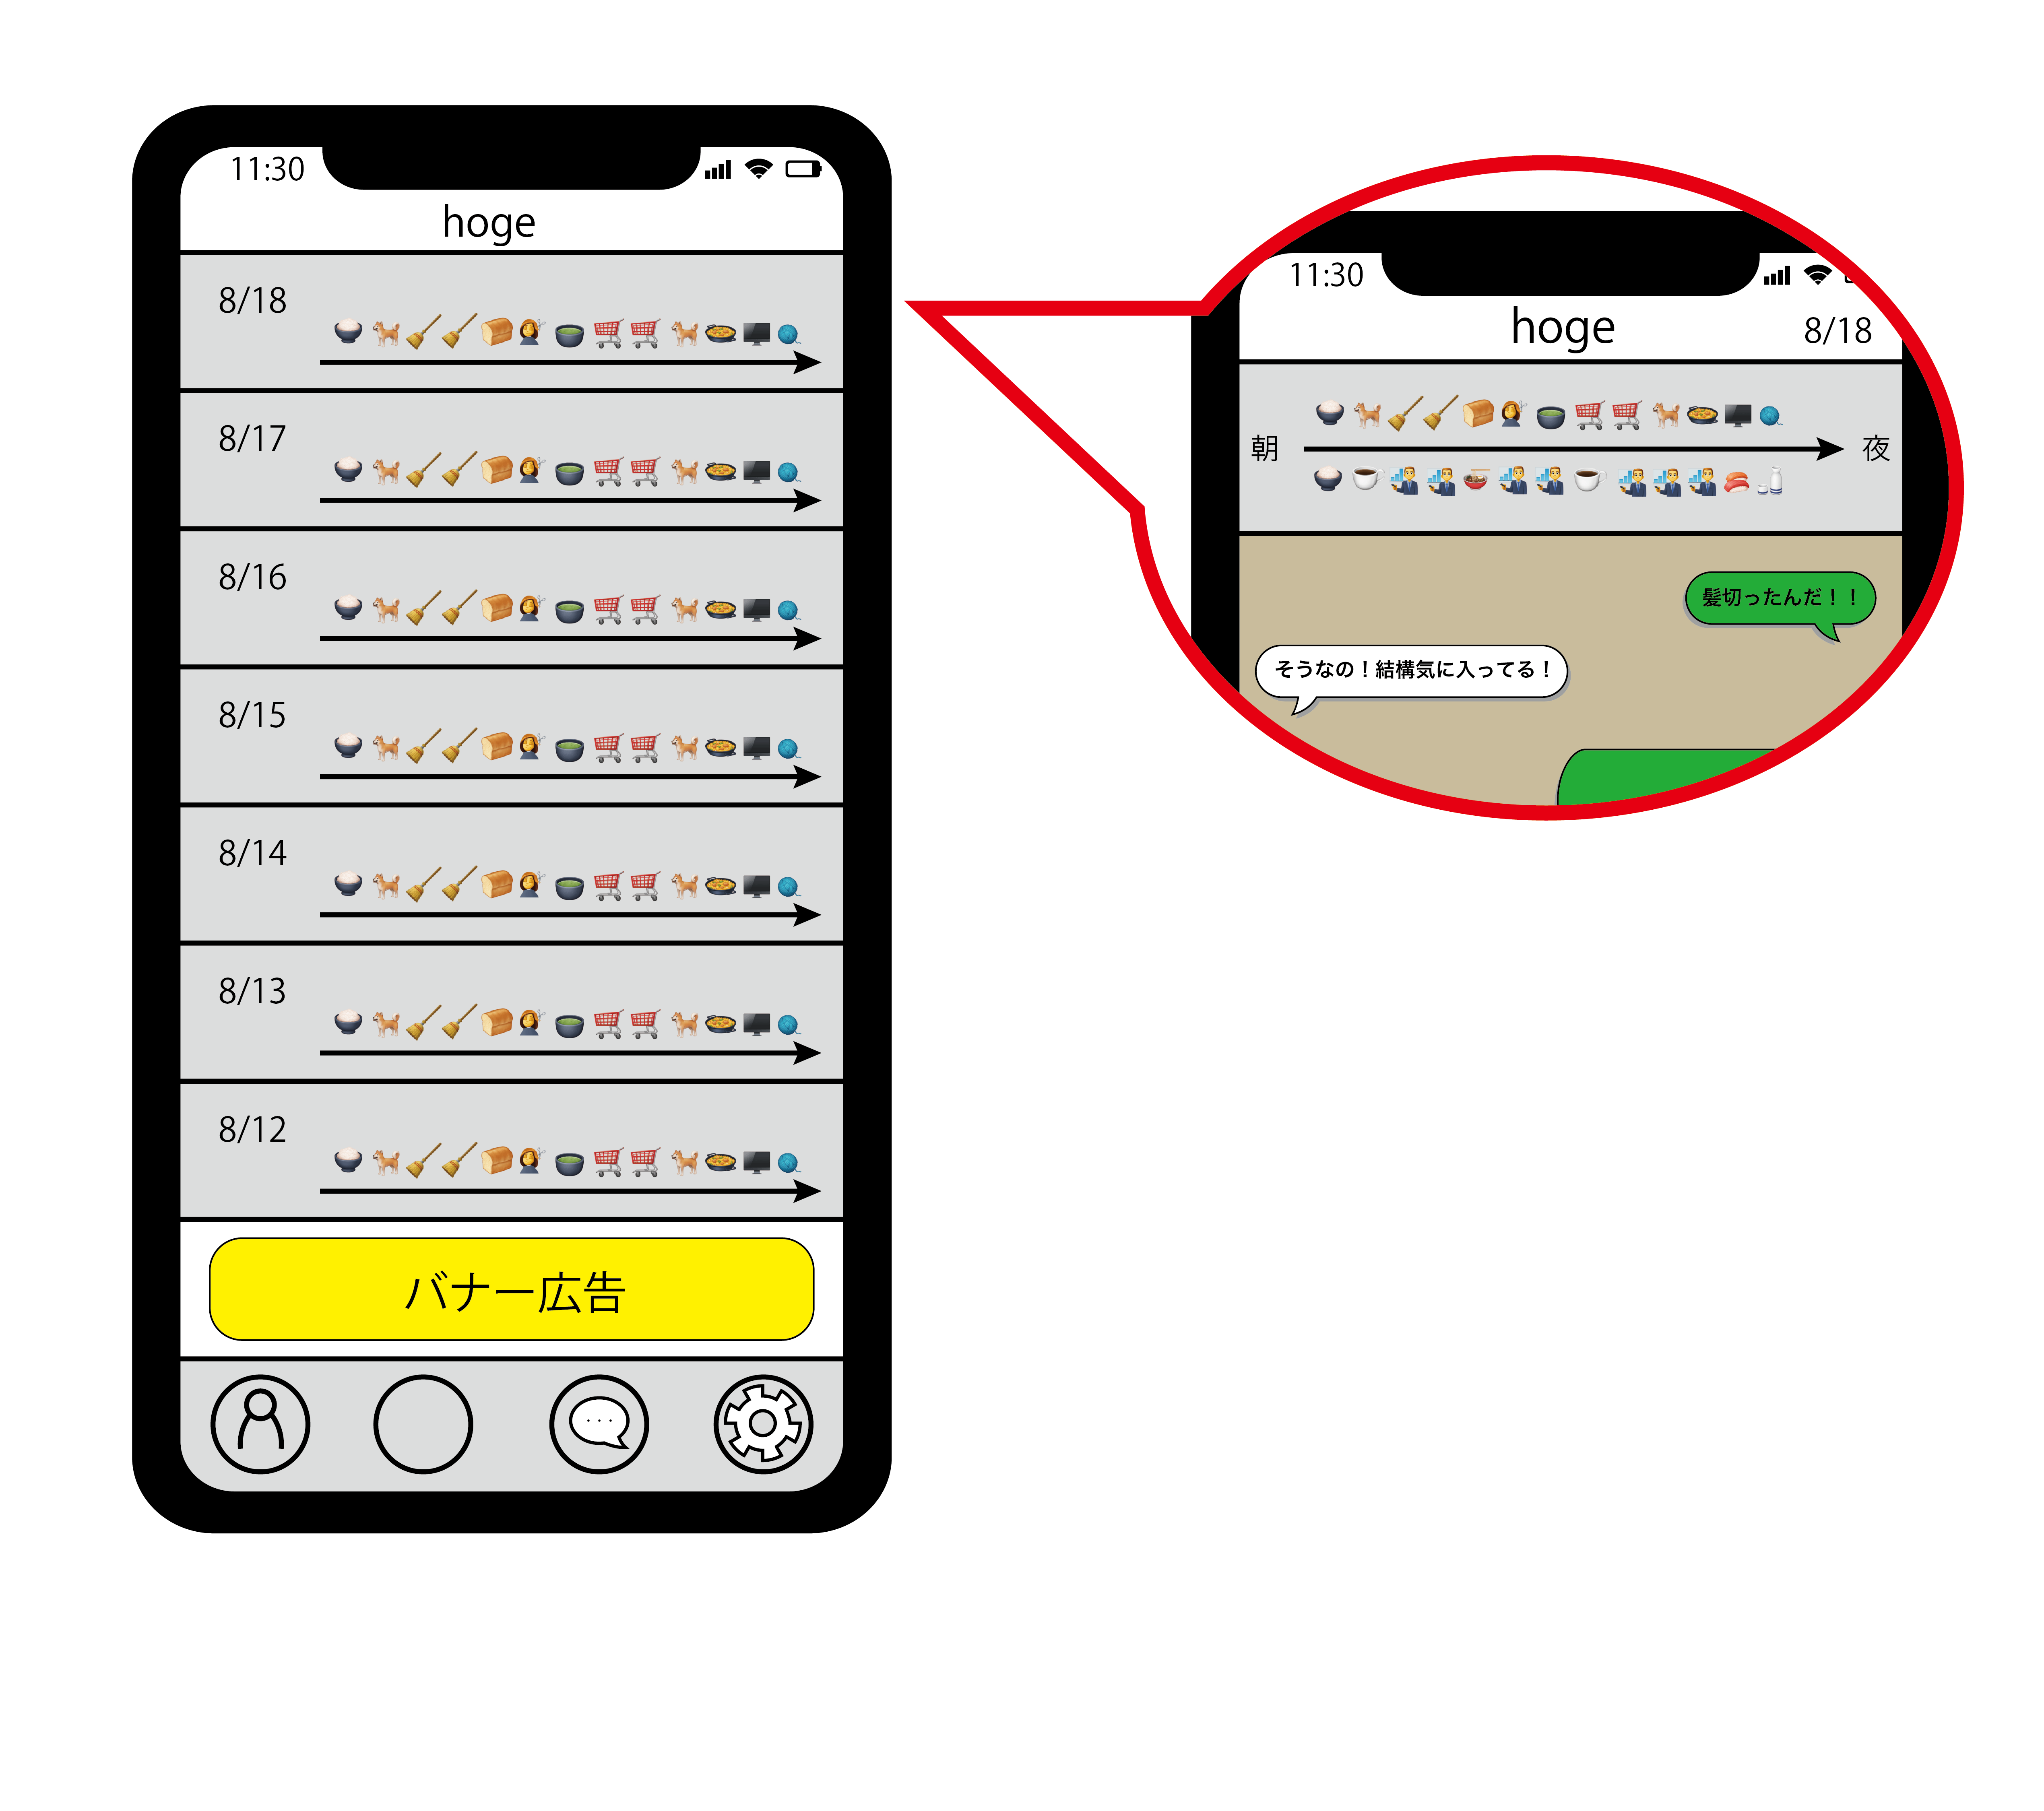
Product Outline
Posts lifelog of the day with emoji (= EmoLog)
Diary with illustrations
Comment on lifelog (1 on 1)
conversation makes your abstract lifelog more in detail !
EmoLog

Slide 11
ターゲットユーザー
(老若男女？？？)
離れた友人知人、家族と繋がり(会話のタネ)が欲しい人
身内, 既存の人間関係を強化したい人

Slide 12
Main Target
Who wants conversation and connection with friends, family living in remote places
Who wants to reinforce relationships with friends

Slide 13
機能の一覧と優先順位
位置情報やSNSの投稿からEmoLogを生成
連絡先登録
EmoLogについてのコメントやチャット
EmoLogが届いたことの通知
連絡先一覧
設定（通知頻度，親密度，関係）
連絡先画面に最近届いたEmoLogを表示
チャット画面での画像の送信
優
先
任
意

Slide 14
Function List & Priority
Generate EmoLog from location or SNS posts
Register your friends
Comments & Chat about EmoLog
Notification of EmoLog arrival
Friend List
Config（notification frequency，closeness，relation）
Display latest EmoLogs on friend list
Send images with chat
Necessary
Optional
Notes:
We list up the functions which our service need
Then discuss their priorities
First, our Emolog service must Generate~ and Register~
These two are especially necessary to realize our concept
Second, our service need the functions for Comments & chat, ~
These three are also required for communication services
Finally, we need config, to display, and to send
These three are optional

Slide 15
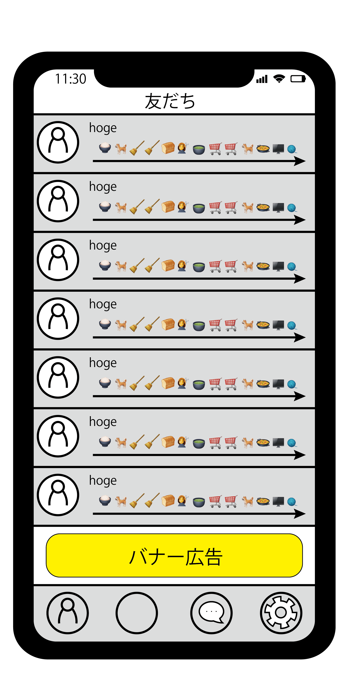
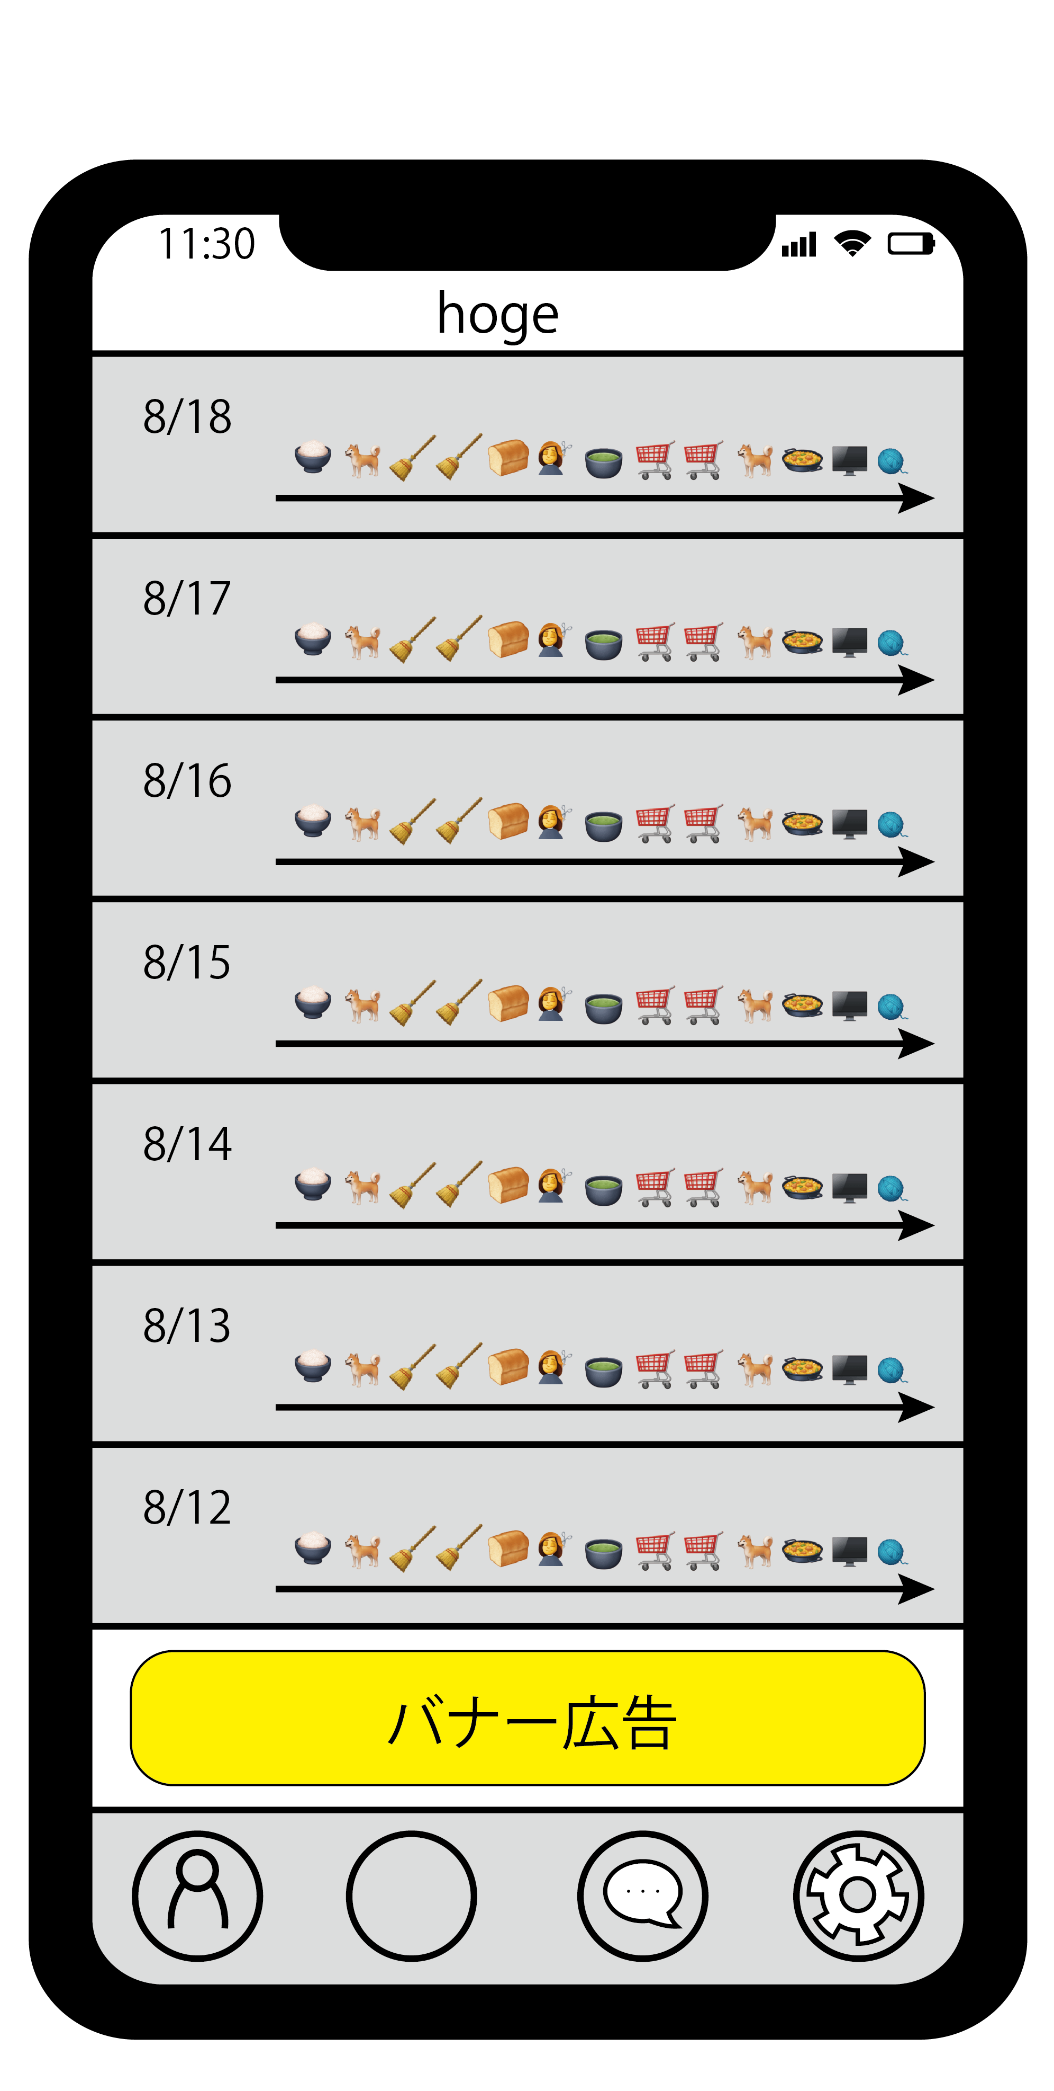
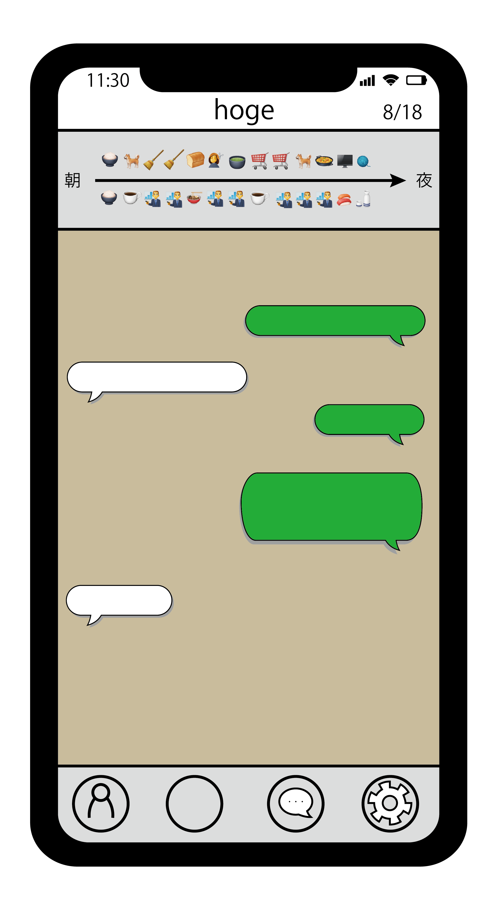

Screen Flow Diagram
Friend list
Emolog list
Chat
Notes:
Finally, I will describe our service Screen Flow Diagram.
Our Service need 3 main Screen for friend list, EmoLog list and chat.
The Friend list screen show the people you know in your contact list.
Each item has a username, an icon and the most recent Emolog.
In this screen, Selecting an item takes you to the Emolog list screen.
When the user finds an interesting Emolog, they select the item to be taken to the chat screen.
The chat screen shows both the other person's and their Emolog at the top, which helps to provide a topic for communication.
Next slide please.

Slide 16
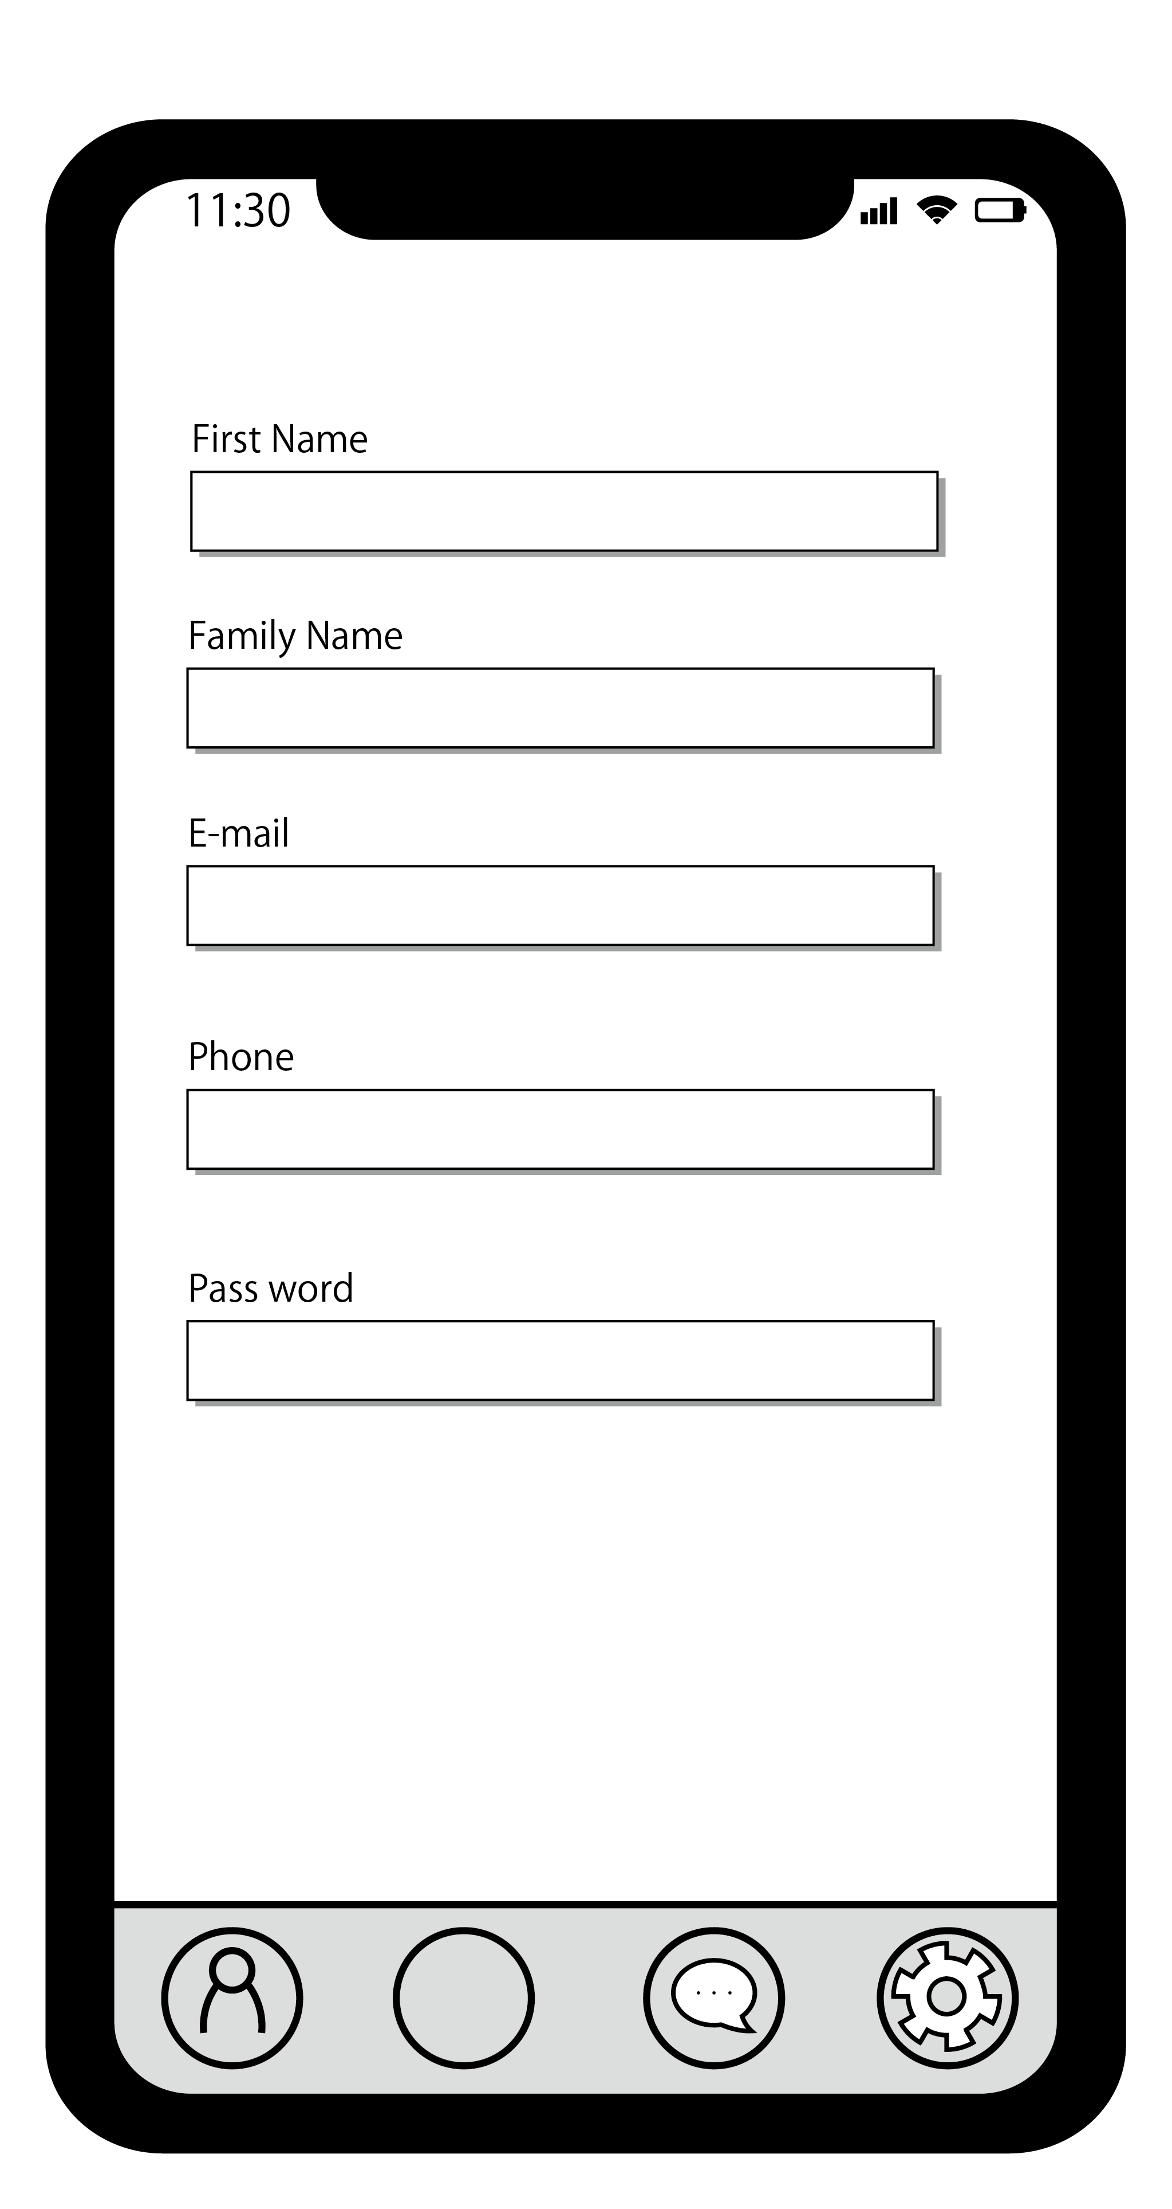
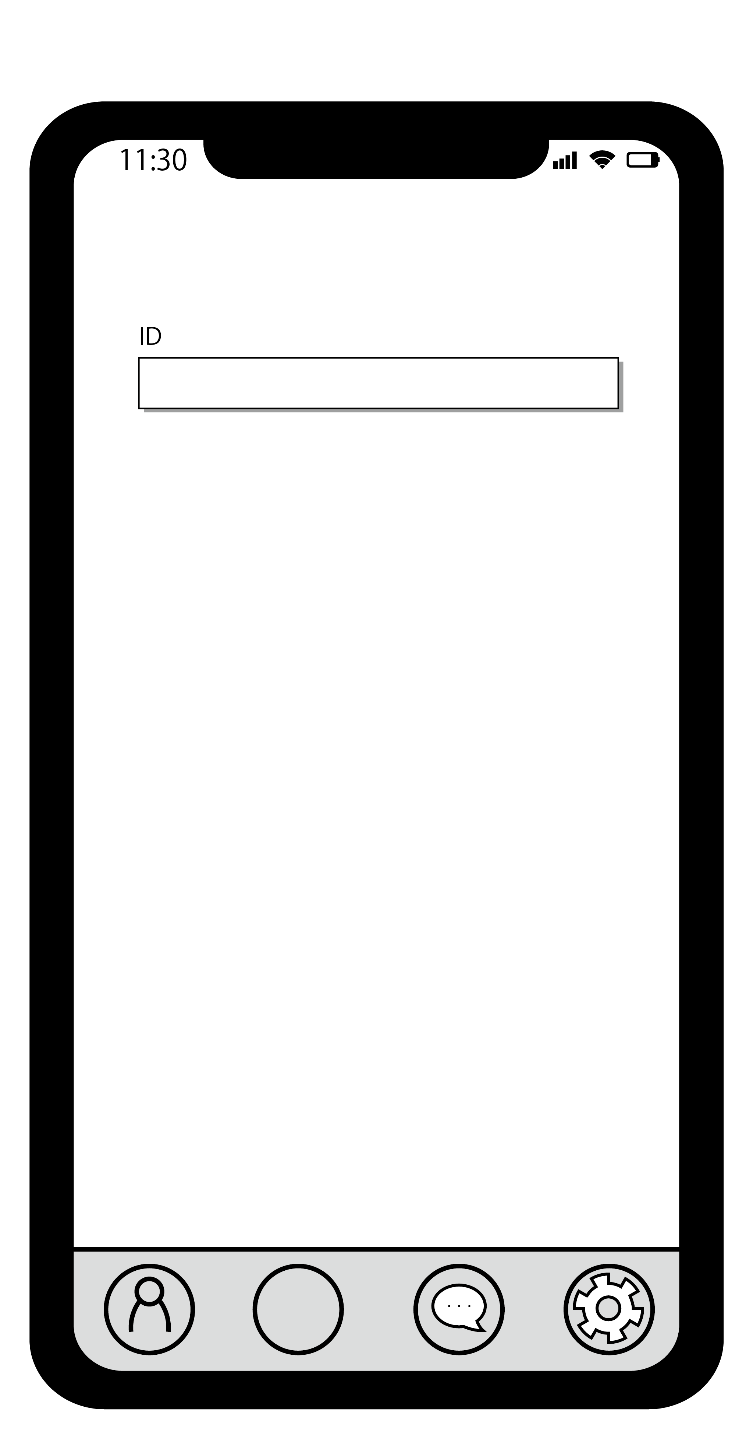


Screen Flow Diagram
User Registeration
Adding Friend
Setting
Notes:
In addition, we are planning to add 3 screens for user registration, adding friend, and setting.
The menu at the bottom of the screen allows you to move between these screens at any time.
Next slide please.
In Setting screen, The user can change the frequency of notifications, general chat settings, Emolog details and more

Slide 17

Closing
We provide the
Service
Powered by 緑の爪
Notes:
We will provide the EmoLog service to connect people online
That's all, thank you

